Slide 1
Deconstructing Digital Scholarship Consultations in the Library
ACRL Preconference
2018 ALA Annual Conference
New Orleans, Louisiana

Slide 2
About Us
Andrew Johnson
Head of Data and Scholarly Communication Services
CU Boulder Libraries
Alix Keener
Digital Scholarship Librarian
University of Michigan Library
Brianna Marshall
Director of Research Services
UC Riverside Library
Joel Thornton
Head of Research and Instruction Services
University of Arkansas Libraries
Chelcie Juliet Rowell
Digital Scholarship Librarian and History Liaison
Boston College Libraries

Slide 3
Preconference Materials
ACRLDigSchol.GitHub.io/deconstructing-consultations

Slide 4
Learning Norms
No one knows everything, together we know a lot.
We can't be articulate all the time.
Move up, move up (aka step up, lean back).
Be mindful of time.
Adapted from Anti-Oppressive Facilitation For Democratic Process by AORTA (Anti-Oppressive Resource & Training Alliance).

Slide 5
Schedule: Part 1
Panel 1, 12:45–1:05
Digital scholarship and academic libraries
Digital scholarship project design and management
Activity 1, 1:05–1:55
Deconstructing digital scholarship projects
Break, 1:55–2:05

Slide 6
Schedule: Part 2
Panel 2, 2:05–2:35
How consultations work at three universities
CU Boulder
University of Michigan
University of Arkansas
Activity 2, 2:35–3:15
Practicing digital scholarship consultations

Slide 7

Line up in order of how far you traveled to get to New Orleans!

Slide 8
Digital Scholarship & Academic Libraries
Brianna Marshall

Slide 9
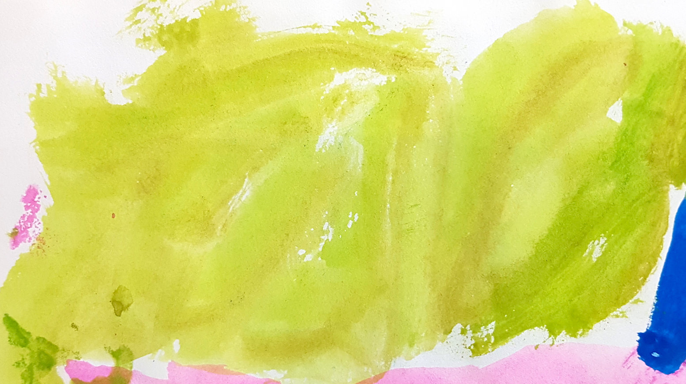
What is Digital Scholarship?
Digital scholarship is the use of digital evidence and method, digital authoring, digital publishing, digital curation and preservation, and digital use and reuse of scholarship.
Abby Smith Rumsey, New-Model Scholarly Communication.
Image used courtesy of Flickr user beamahan (CC BY NC ND)

Slide 10
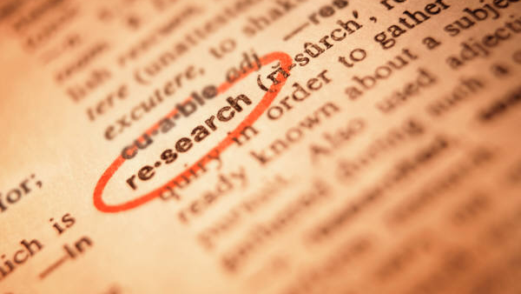
What is Research?

Slide 11
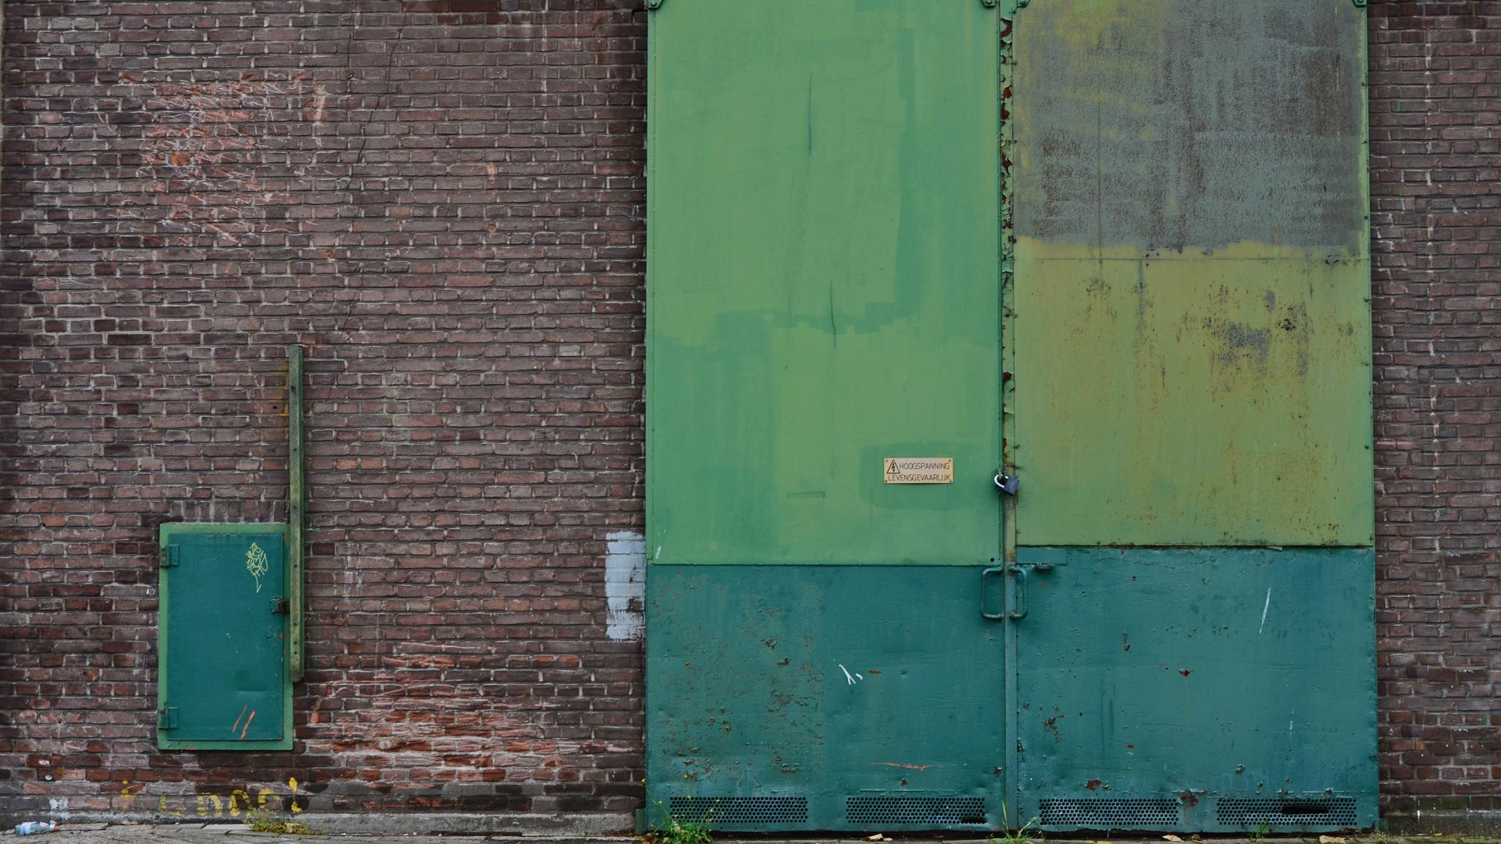
Digital Scholarship Services
Roles
Spaces
Collaborations
Image used courtesy of Flickr user astrid (CC BY NC ND)

Slide 12
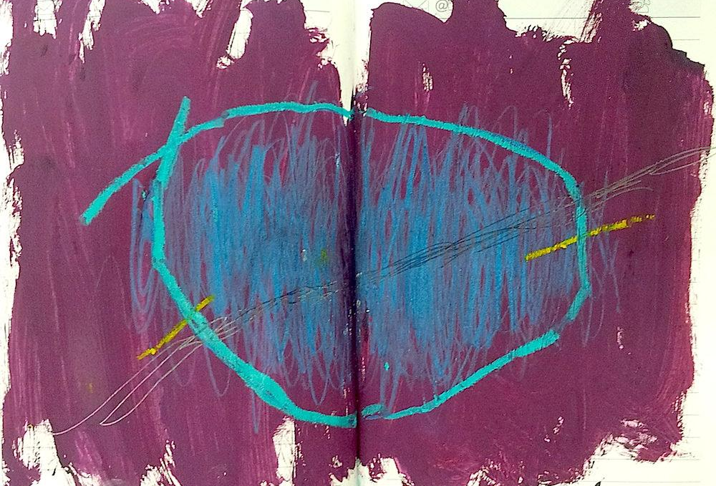
Defining Success
Image used courtesy of Flickr user beamahan (CC BY NC ND)

Slide 13
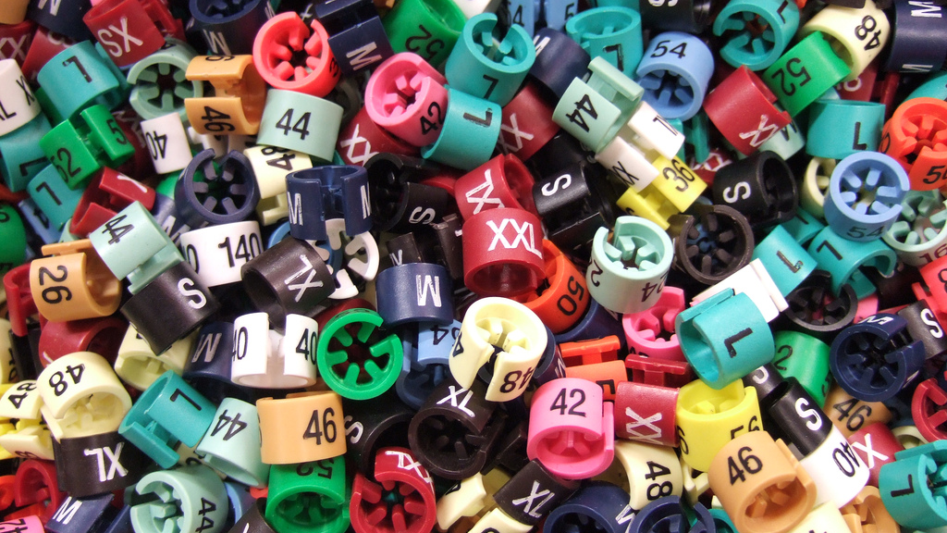
One size doesn’t fit all
Image used courtesy of Flickr user sooperkuh (CC BY 2.0)

Slide 14
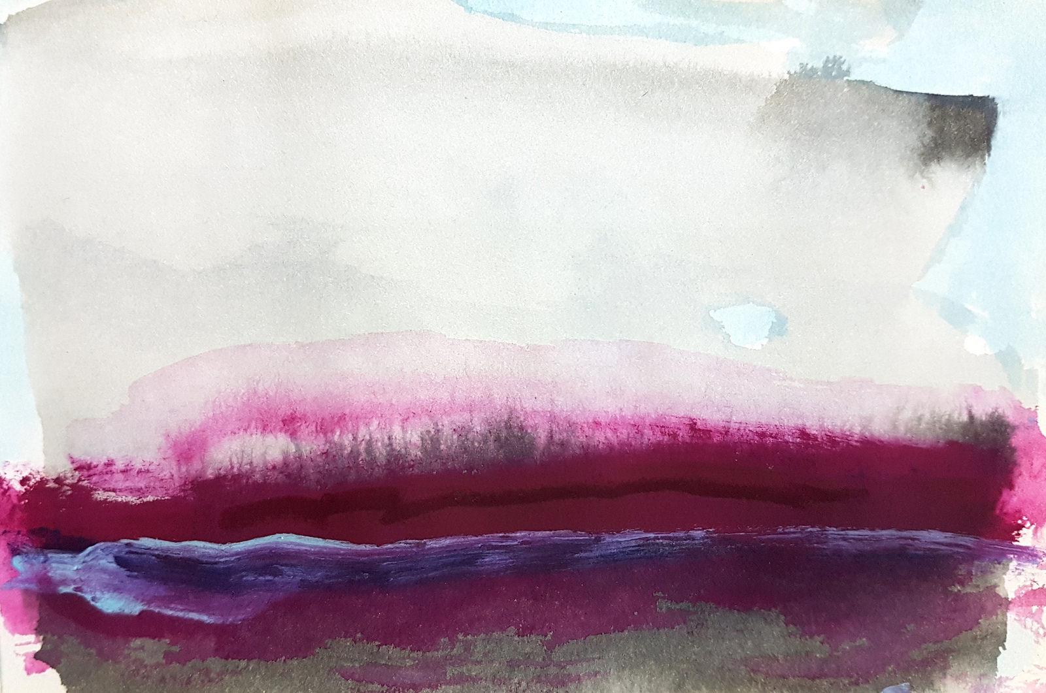
Routinizing, Normalizing, Depersonalizing
Dan Cohen, Institutionalizing Digital Scholarship (or Anything Else New in a Large Organization)
Image used courtesy of Flickr user beamahan (CC BY NC ND)

Slide 15
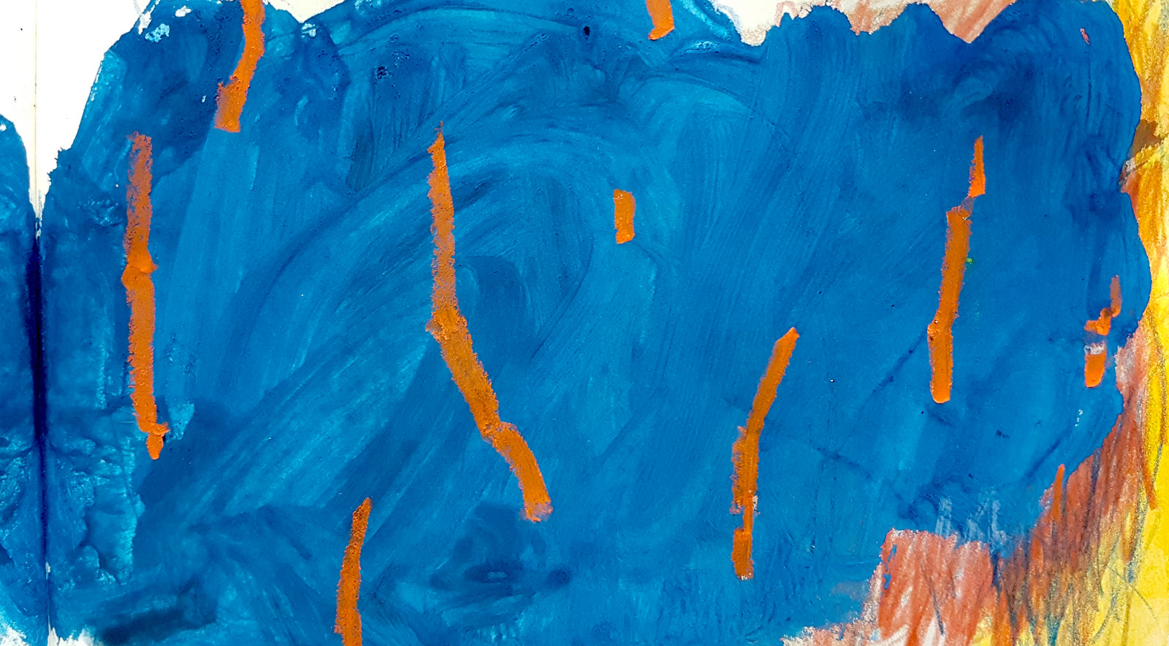
With that context, our structure will be...
Exploring
Digital Scholarship Projects
&
Navigating
Digital Scholarship
Consultations
Image used courtesy of Flickr user beamahan (CC BY NC ND)

Slide 16
Digital Scholarship Project
Design & Management
Chelcie Juliet Rowell

Slide 17
What’s a project?
A temporary endeavor undertaken to create a unique product, service or result.
Definition by the Project Management Institute.

Slide 18
What’s project management?
Principles, methods, tools and techniques for shepherding projects to completion in the context of a specific and unique organizational environment.
Knutson, Joan, and Ira Bitz. Project Management: How to Plan and Manage Successful Projects. AMACOM Division of American Management Association, 1991.

Slide 19
How projects unfold
Defining a project
Honing in on purpose and scope
Building your team
Planning a project
Mapping relationships among tasks, time, and resources
Implementing a project
Monitoring progress
Enforcing or revising project plan

Slide 20
Building a team
What knowledge, skills, or abilities does our team need in order to carry out this project?
Do we as a team possess this knowledge?
If not, we have options:
Team members re-skill.
Add new members with requisite knowledge to team.

Slide 21
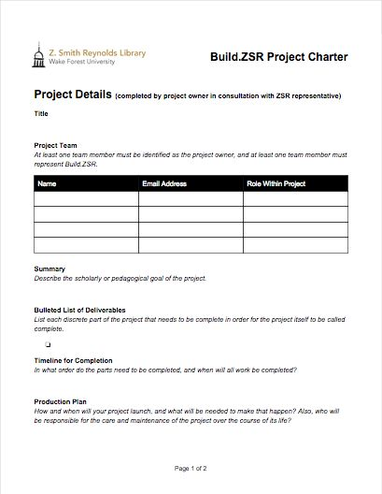
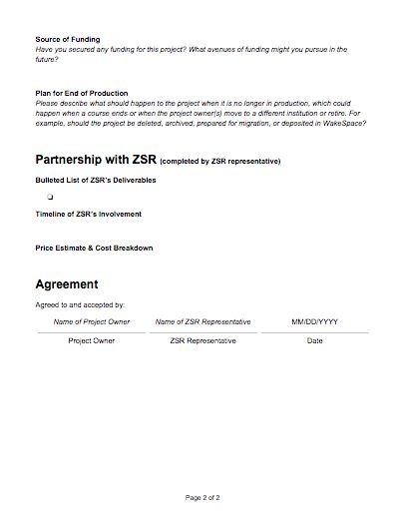
Creating a project plan
Build.ZSR Project Charter. Z. Smith Reynolds Library, Wake Forest University. build.zsr.wfu.edu.

Slide 22
Templates for project plans
Mirza, Rafia, Brett Currier, and Peace Ossom Williamson. 2016. “Memorandum of Understanding Workbook, Version 1.0.”
Varner, Stewart. 2014. “Project Charter.” Stewart Varner: Scholarship, Libraries, Technology, May 6.
Varner, Stewart. 2014. “Project Proposal Form.” Stewart Varner: Scholarship, Libraries, Technology, May 8.
UCLA Library. 2015. “Special Collections Digital Project Toolkit.”

Slide 23
Why document your project plan?
Partnership agreements express intellectual and even emotional support for projects; these agreements universalize intent.
Burress, Theresa, and Chelcie Juliet Rowell. “Project Management for Digital Projects with Collaborators Beyond the Library.” College & Undergraduate Libraries 24, no. 2–4 (November 2017): 1–22. DOI:10.1080/10691316.2017.1336954.

Slide 24
During Activity 1, ask yourself:
How would you break the work of the project down into discrete tasks?
If you were undertaking this project, how would you build your project team?

Slide 25
Activity 1:
Deconstructing Digital Scholarship Projects

Slide 26
Consultations at CU Boulder
Andrew Johnson

Slide 27
RDM consultation process at CU Boulder
Requests typically sent to a central email address
Often unclear where questions should go
Negotiation process helps determine actual need
Usually set up an in-person consultation
Also open drop-in hours with digital humanities, statistics, and research computing consultants

Slide 28
A recent example
Initially: “I need help getting my Excel data into a database. What database program do you recommend?”
After negotiation: “I need my dissertation data to be archived with ICPSR. They prefer SPSS/SAS/Stata files. What else do I need to do in order to deposit my data?”

Slide 29
The consult itself
Pre-consult research (e.g., review ICPSR info)
Ask researcher to walk through project or data
Listen and ask questions to gauge best approach to meeting needs
Explain (without jargon) the steps required to get from point A to point B

Slide 30
Consult next steps
Identify which steps researcher needs to do and which steps we can support
Make sure immediate needs have been met and next steps are clear
Follow up

Slide 31
Typical consultation requests
I have a grant proposal due soon. How do I write a Data Management Plan for it?
Where do I put my data in order to comply with a journal data access policy?
We have data that we’re hosting on our website. Can you help us get DOIs for it?
Where do I store my data if it has privacy issues?

Slide 32
Reflections
My referrals to other units, experts, or resources are important contributions.
I learn something new from almost every consult, from research before or after.
It’s okay to say “I don’t know, but I can find out.”
Sometimes it’s tricky to balance promoting local services and resources with researcher’s needs.

Slide 33
Consultations at the
University of Michigan
Alix Keener

Slide 34
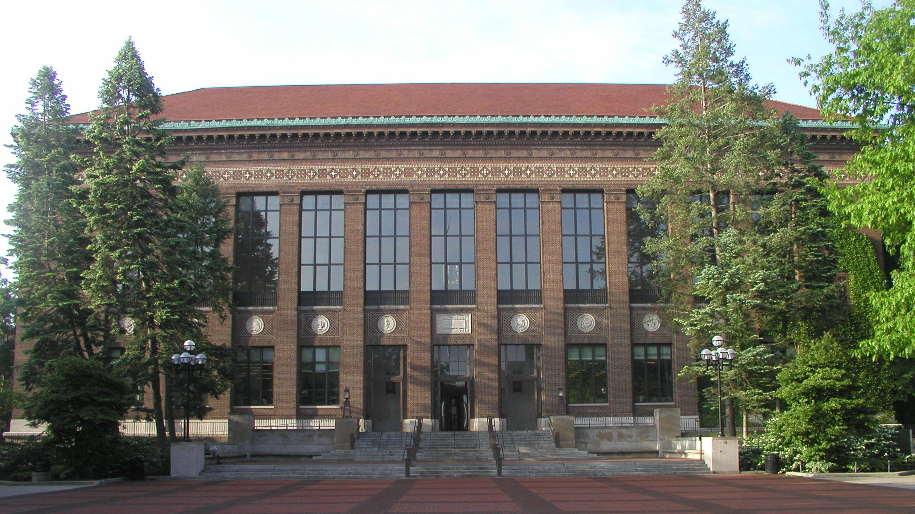
University of Michigan Library

Slide 35
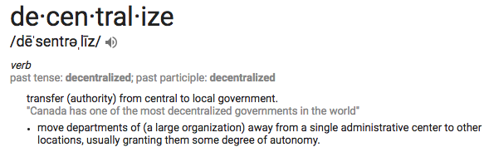
We are decentralized.
Lack of formal structure for digital scholarship support in the library as well as the whole campus
However, many pockets of rich expertise across library, departments, institutes

Slide 36
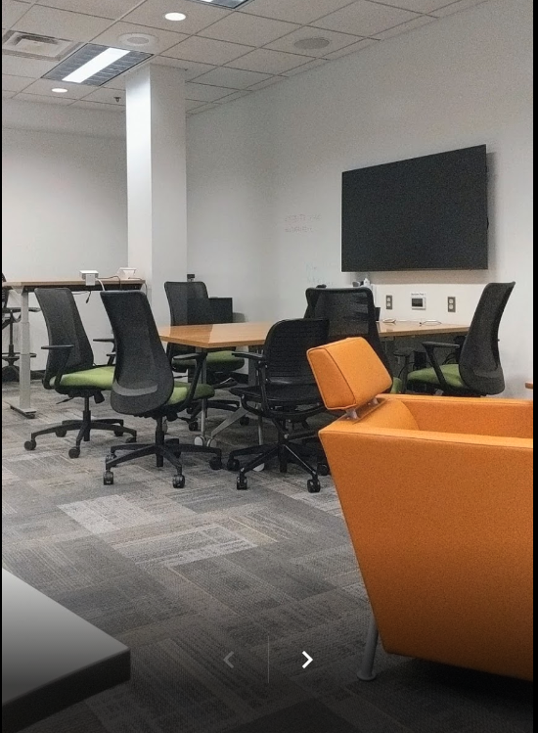
Our consultation space

Slide 37
Common Consultation Requests
How can I build a dataset from social media sites like Twitter and Reddit?
How can I organize my research assets (PDFs and photos of documents) from all of my trips to the archive?
What’s OCR? What’s text analysis?
I saw you present different tools for creating maps at a workshop or in my class. How do I get started? What do I need to know?

Slide 38
Consultation Flow
Subject liaison
Functional specialist (me, Visualization, Metadata, Digital Pedagogy…)
Functional specialist (me, Visualization, Metadata, Digital Pedagogy…)
Outside the library (Center for Research on Learning and Teaching, IT Advocates...)

Slide 39
If it’s confusing for us, it’s confusing for users.

Slide 40
Diagnostic Questions
Ask for context: their dissertation topic or research area.
Ask how much time they’re willing to invest. Is this part of their main research or no? Are they willing to learn a new tool?
Make sure everyone understands whether this is a question about data collection, analysis, digital publication or presentation, or all of the above.

Slide 41
Experiments, Present and Future
Group email address (library-ds@umich.edu) that reaches five librarians:
Digital Scholarship
Digital Pedagogy (two people)
Metadata Projects
Visualization
Listed on library digital scholarship support web page, used in workshop advertisements, and distributed to faculty

Slide 42
Further Experiments, Present and Future
Digital Scholarship office hours with functional specialists held every other week for one hour
Decreasing one-off open workshops
More active and intentional partnership with IT Advocates from the College of Literature, Science, and the Arts:
Meetings to determine what services each group does— and does not—provide
Virtual map of campus with resources and services pinpointed

Slide 43
Consultations at the
University of Arkansas
Joel Thornton

Slide 44
Digital Scholarship Ecosystem
Metadata Services
Data Services Librarian
Scholarly Communications
Center for Advanced Spatial Technology
Subject Liaisons
User
OER
Center for Statistical Research & Consulting
High Performance Computing
Digital Services
Research Data Services
Center for Social Research
Notes:
Institutions are at different levels of maturity
Operate as a loose federation w/o a central coordinating hub (fragmented)
Goal: Work towards formalizing partnerships
Create synergy through shared cost, infrastructure, and programming with minimal duplication

Slide 45
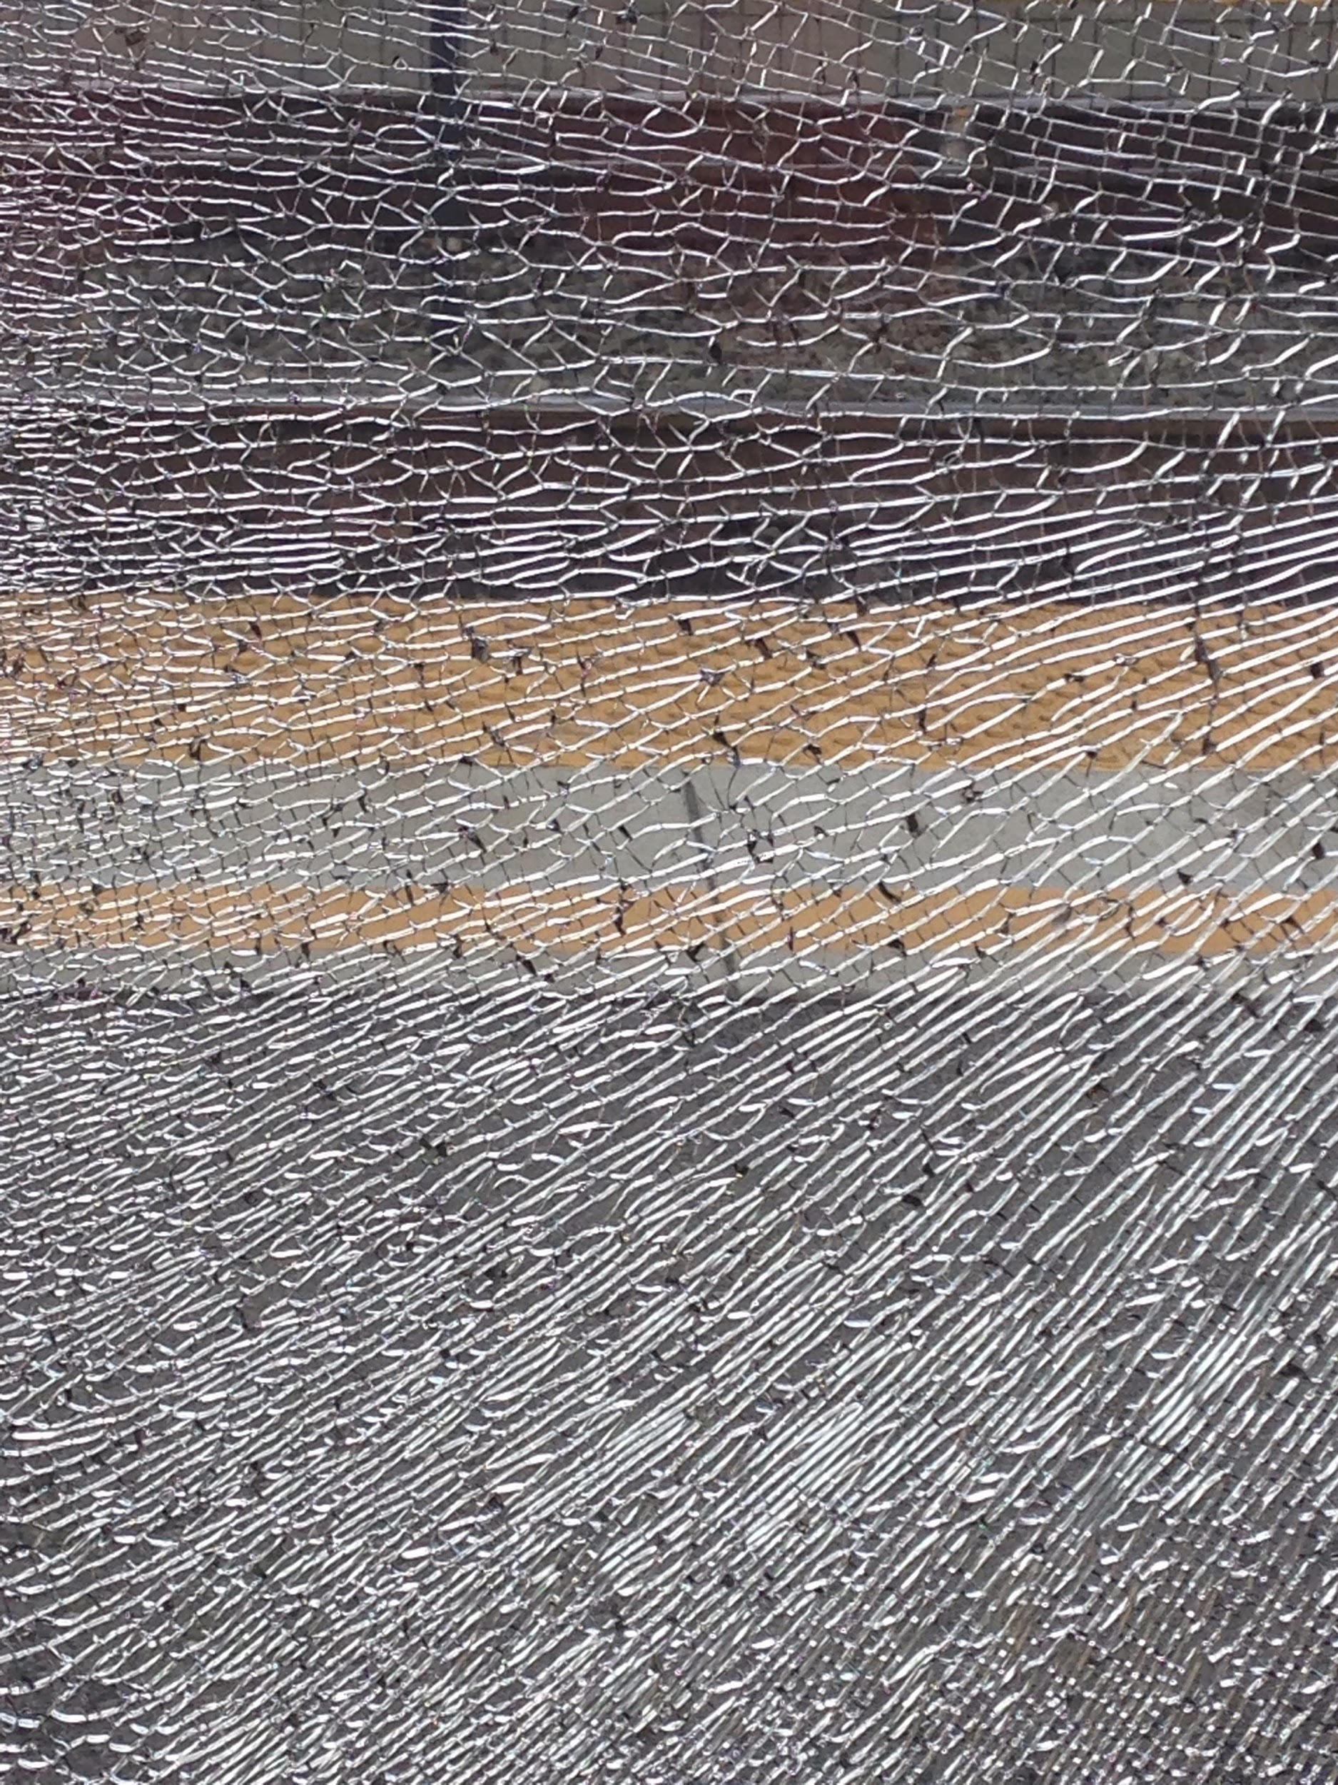
Consultations
Notes:
Expertise is fragmented and dispersed

Slide 46
Consultations
Ideation
Research
Creation
Dissemination
Notes:
Engage at any stage of the process

Slide 47
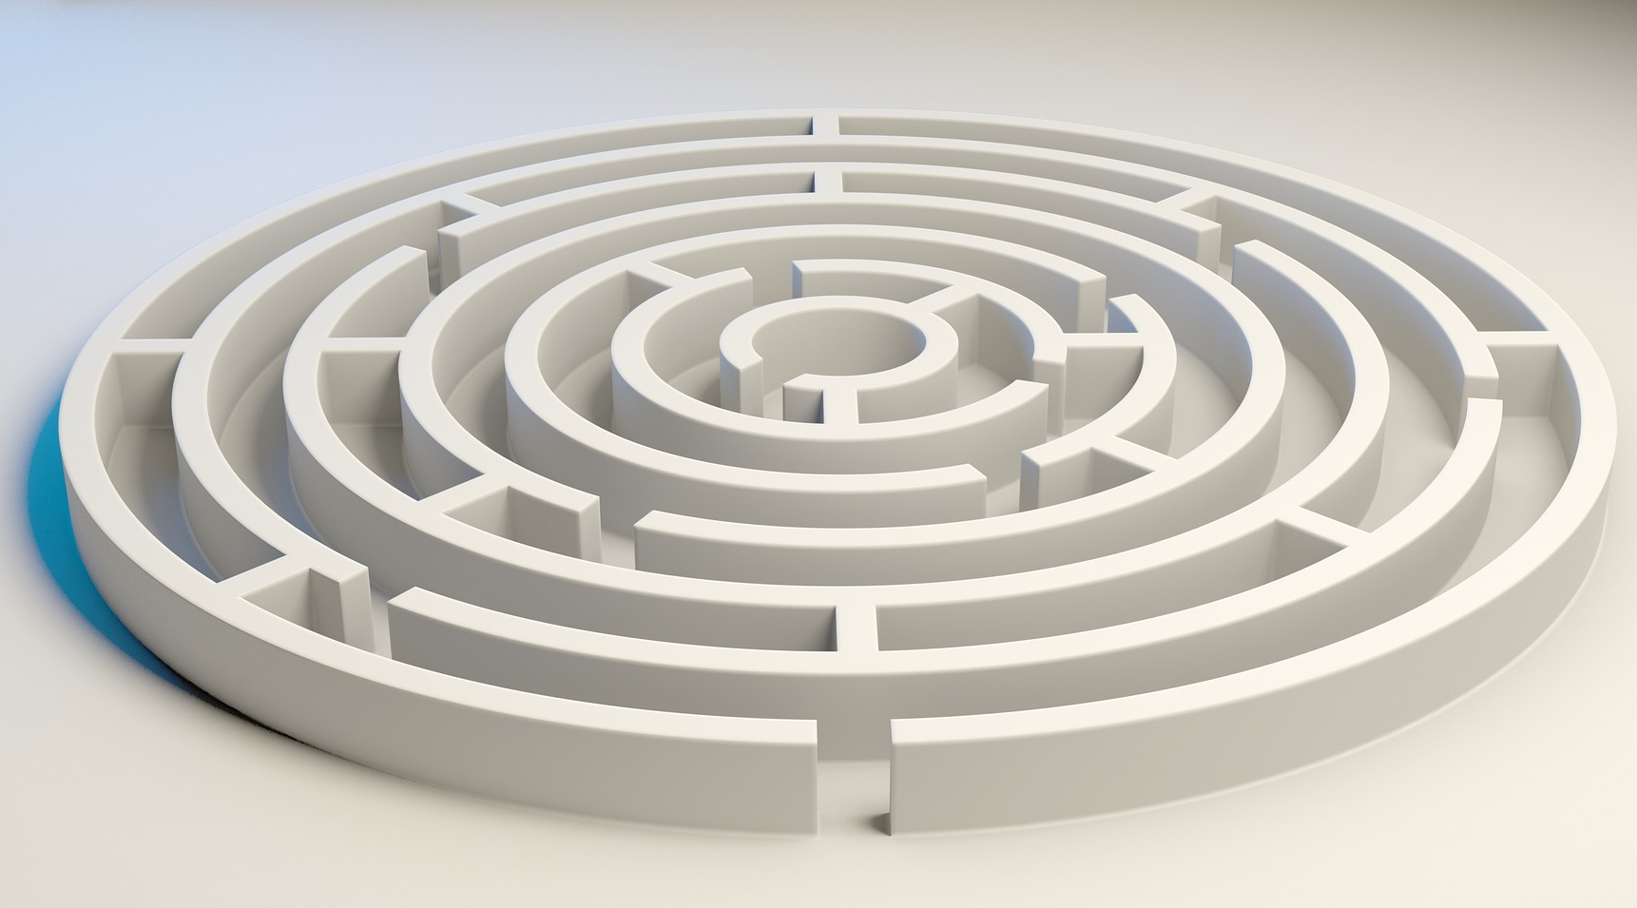
Problem Solving
Notes:
About problem solving

Slide 48

Focus and Scope
Notes:
Focus and scope
Know what you will and can do.
Know what you won’t do.

Slide 49
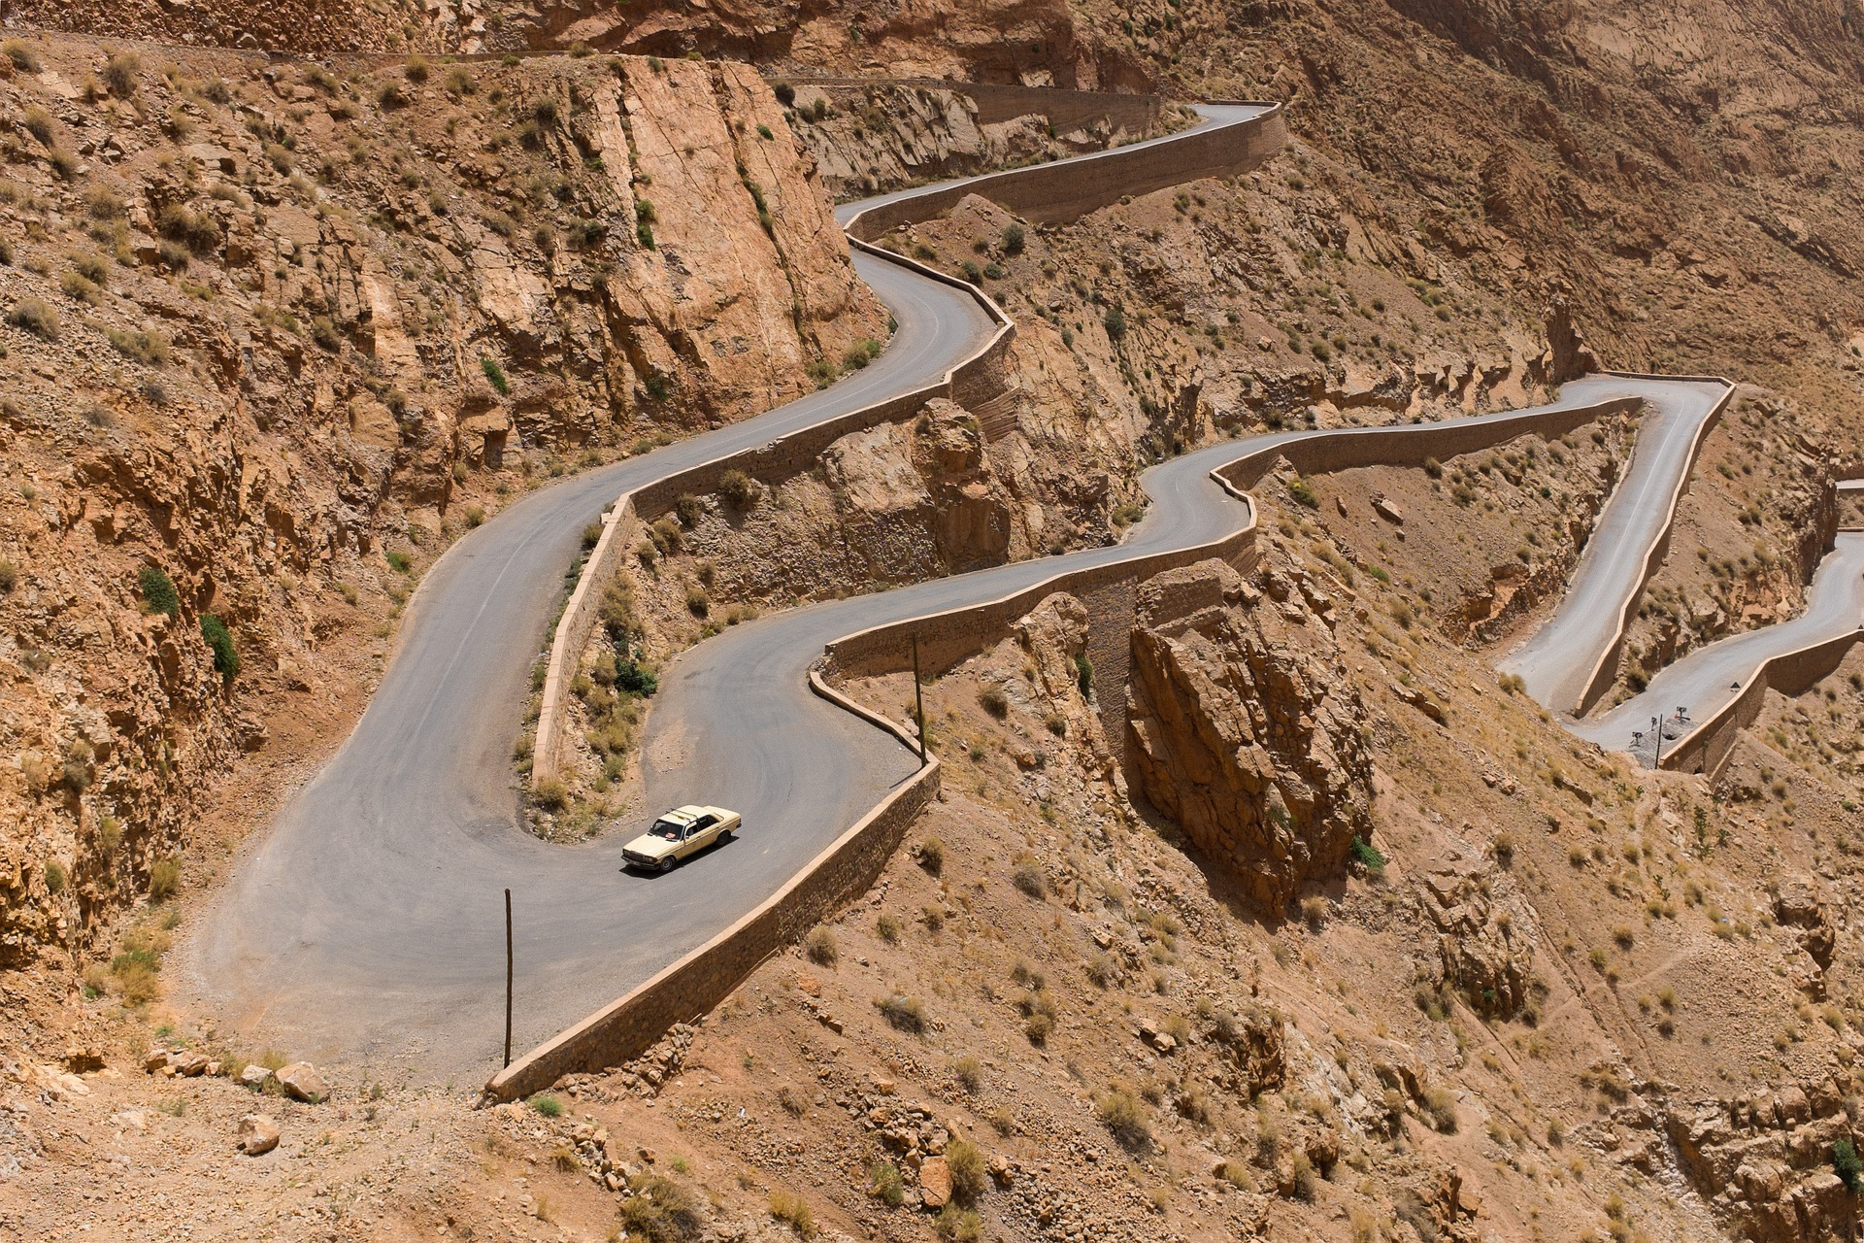
Life of its own
Notes:
Each project takes on a life of its own.
Each project is unique and take various unpredictable paths.

Slide 50
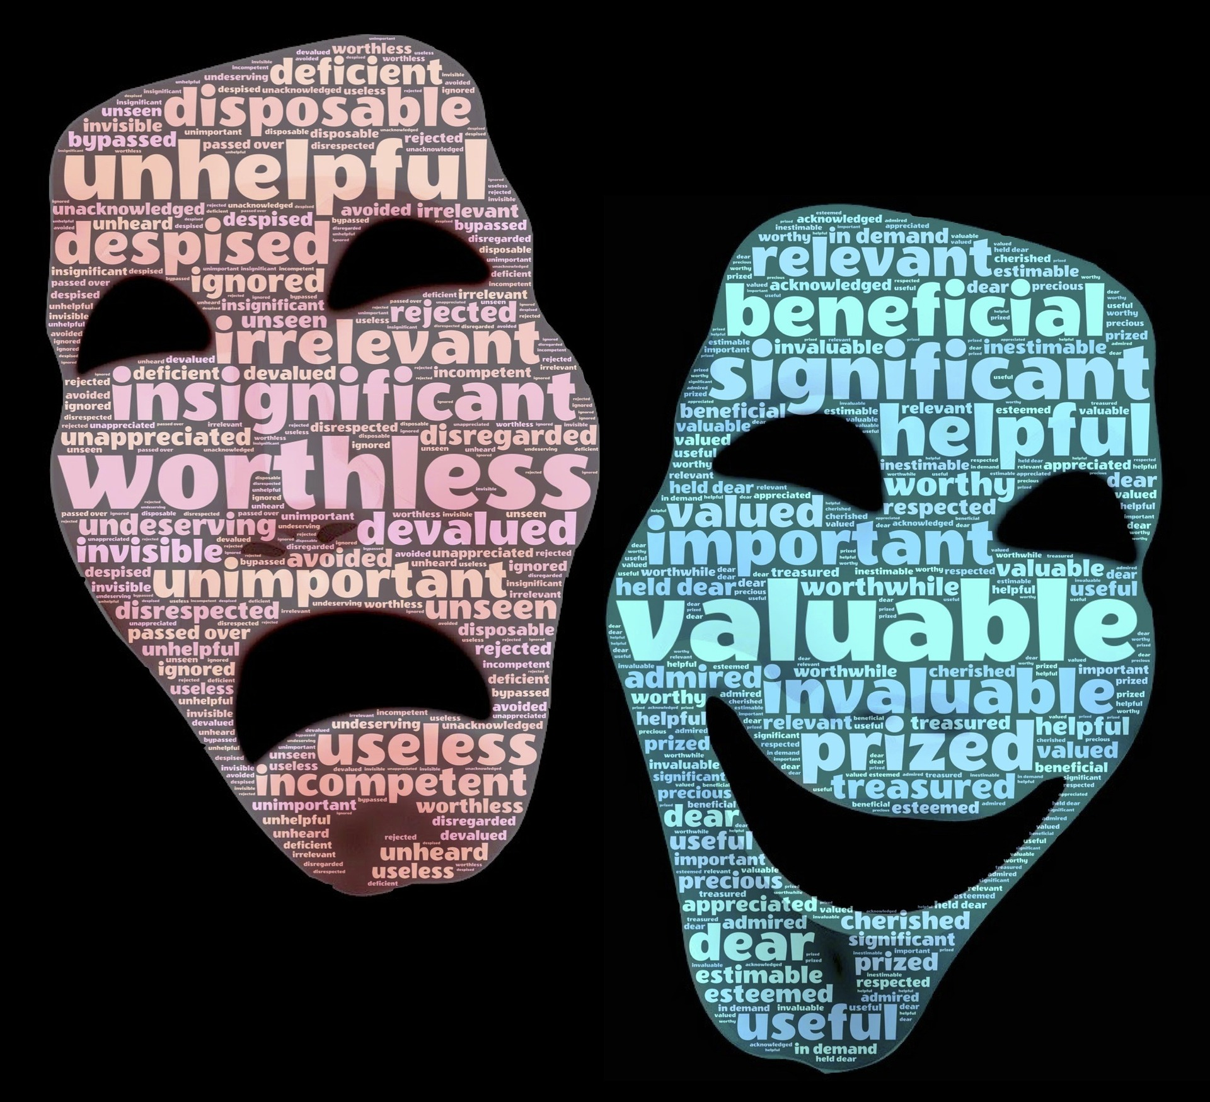
Value
Notes:
About delivering value

Slide 51
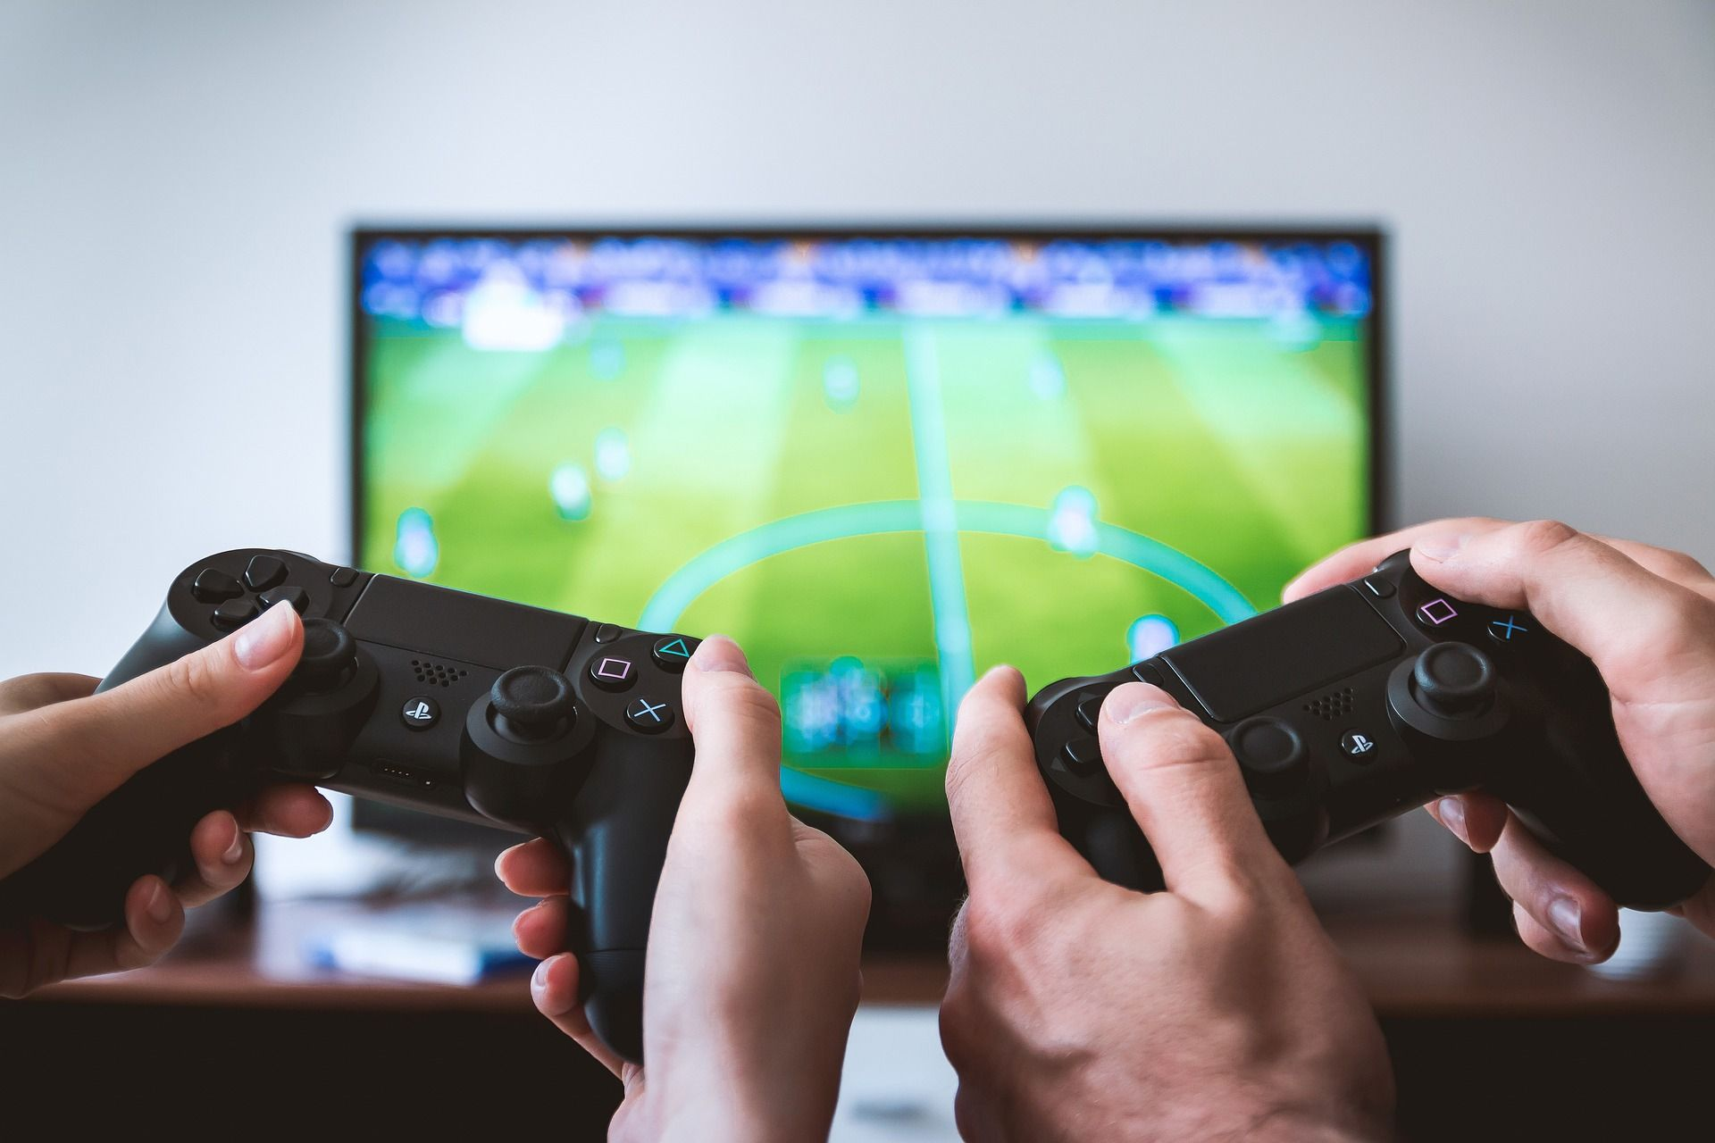
Gaming Example
Gaming
Project Scope
Virtual Reality
Notes:
Tesseract Center for Immersive Environments and Game Design
To explore its ancient streets and houses in Virtual Reality, using the Oculus and Gear headsets
Prof needed high resolution images of resources we owned

Slide 52
Activity 2:
Practicing Digital Scholarship Consultations

Slide 53
Thank you!
Don’t hesitate to stay in touch.

Slide 54
Re-use, adapt!
github.com/ACRLDigSchol/deconstructing-consultations

Slide 55
See you again this weekend at ALA?!
Bridging the Gap: Supporting Subject Liaisons to Become Ambassadors for Digital Scholarship in Academic Libraries
Sunday, 4:00–5:00
Morial Convention Center, Rm 392 Favorite
Digital Scholarship Section Social
Sunday, 6:00–8:00
Bakery Bar, 1179 Annunciation St

